Slide 1
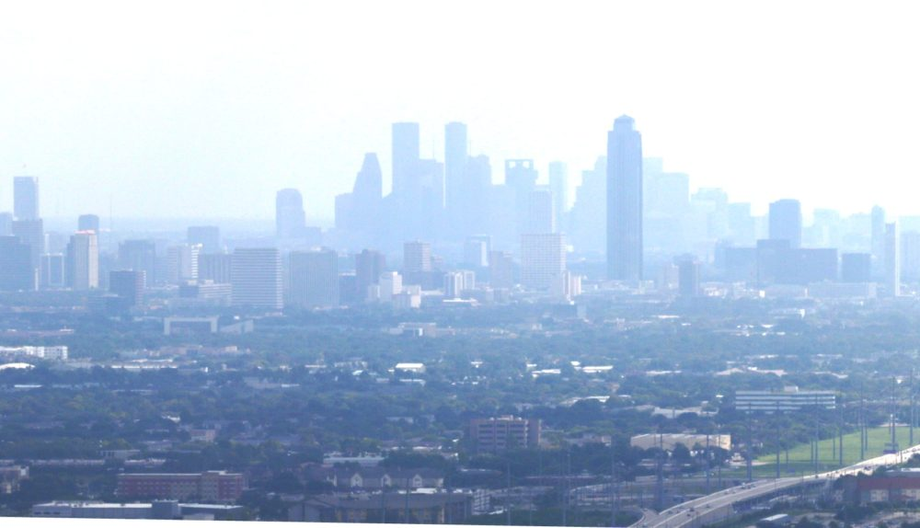
An Analysis of Aerosol Optical Properties and VOCs in Houston Air Quality
Presented by
Nushrat Jahan Chowdhury
Bio-5202

Slide 2
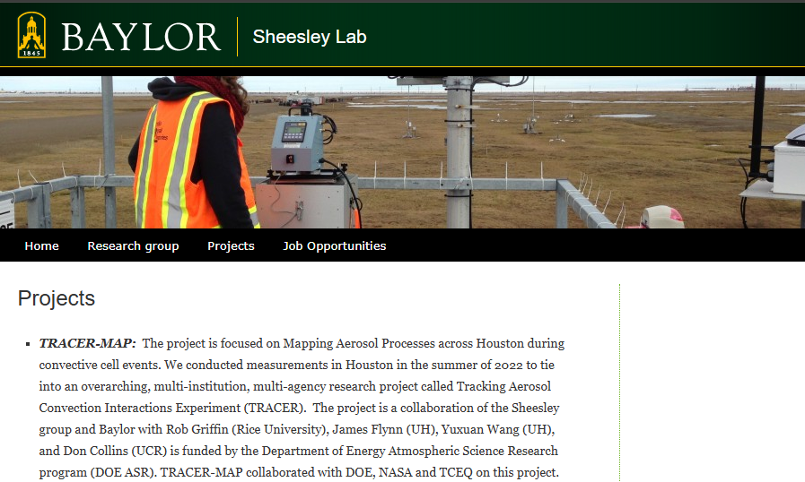
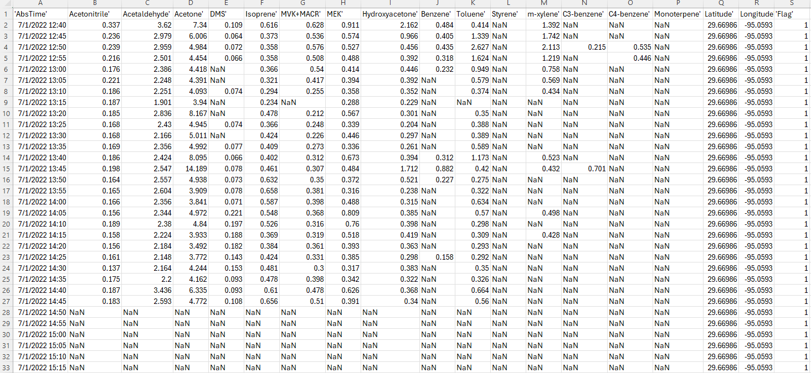
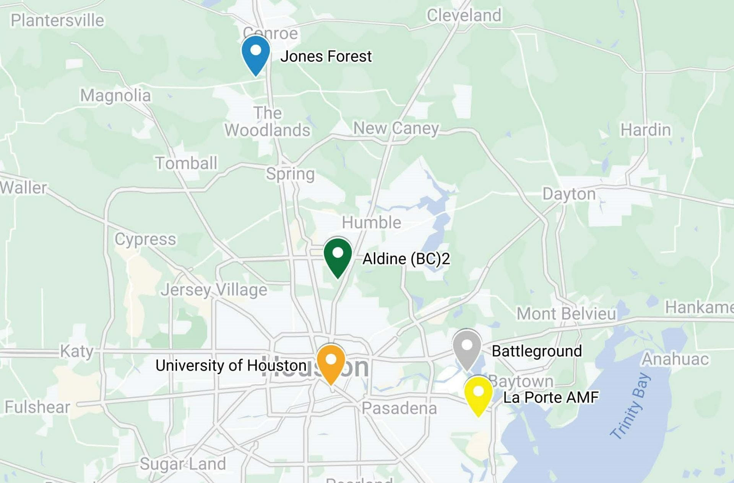
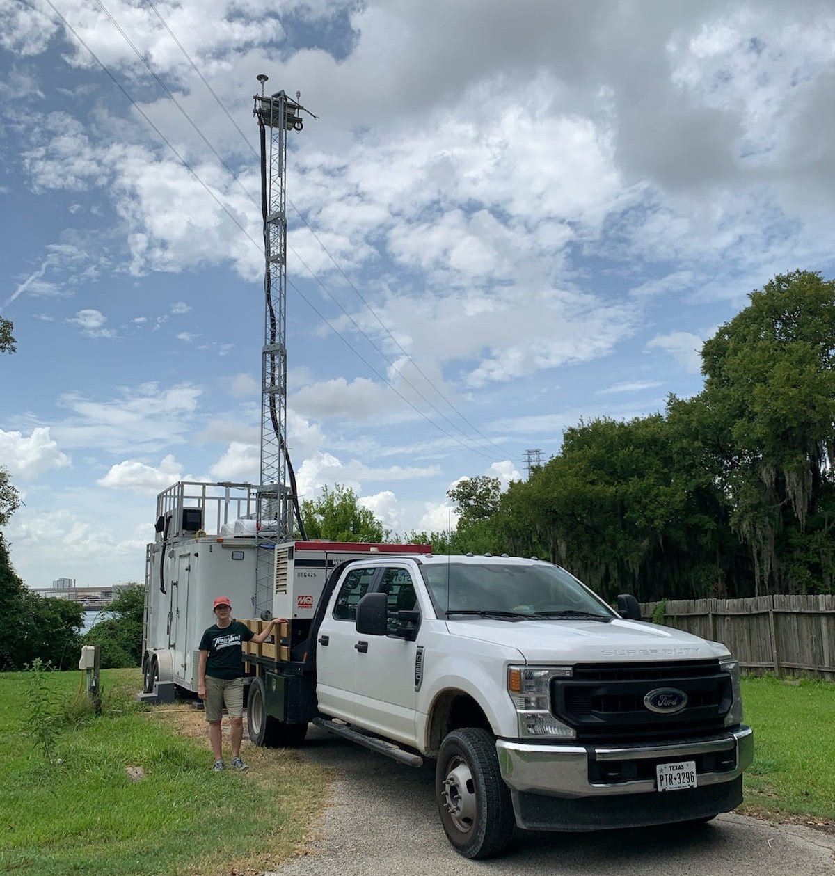
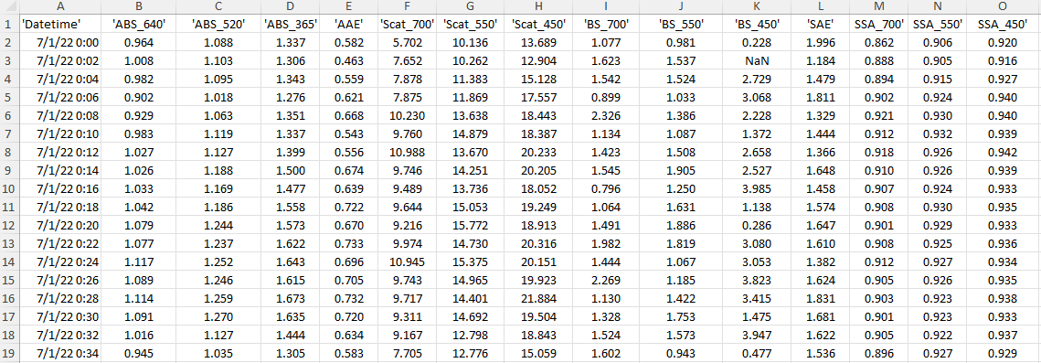
Data source

Slide 3
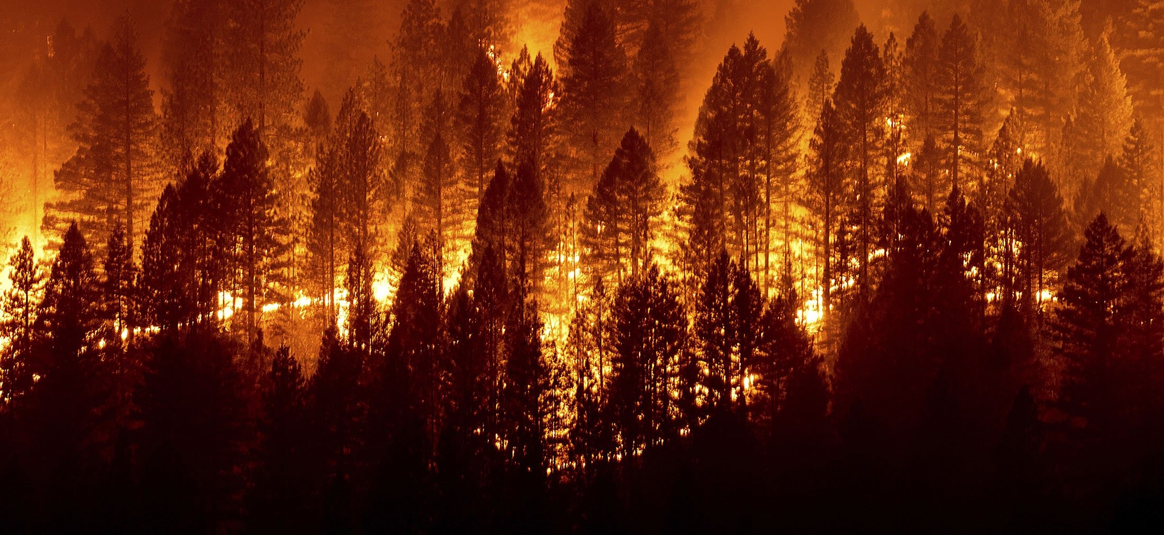
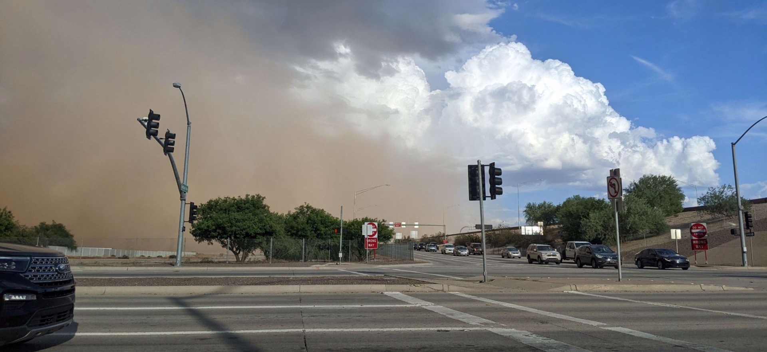
Research Question(s)
How do Absorption Ångström Exponent (AAE), Scattering Ångström Exponent (SAE) and VOCs vary over July and August in Houston?
Are there any biomass burning event during those periods?

Slide 4
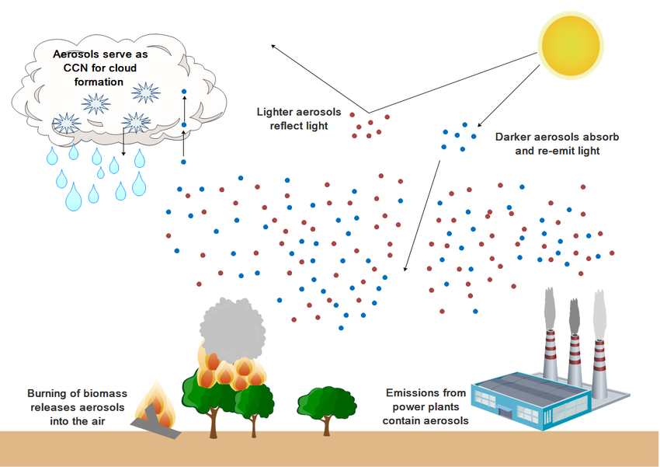
Objective(s)
Higher SAE
Enhanced light scattering at short wavelengths
Develop time series graphs of AAE, SAE and VOCs.
Identify biomass burning events.
Provide a reproducible R script for researchers to analyze similar datasets.
(fine-mode particles. Coarse-mode particles)
(Black carbon, Brown carbon, mineral dust, etc.)
Increased absorption at short wavelengths
Higher AAE
AAE describes how strongly aerosols absorb light across different wavelengths. It increases when there is more brown carbon, which absorbs more at short wavelengths (blue/UV).
SAE shows how much aerosol scattering varies with wavelength. High SAE means more fine particles that scatter short-wavelength light (like blue light).

Slide 5
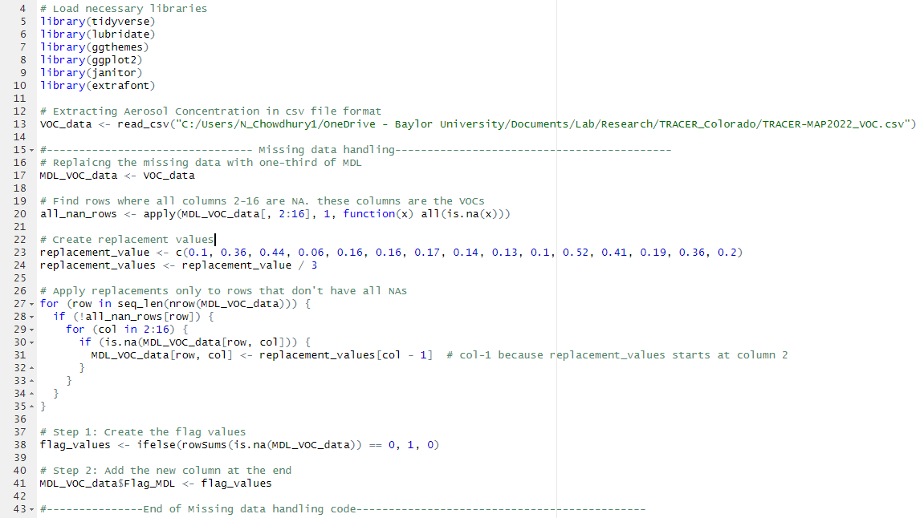
Approach
Load the necessary libraries

Slide 6
Approach
Load the VOCs dataset

Slide 7
Approach
Handle missing data
Data imputation with one-third of MDL

Slide 8
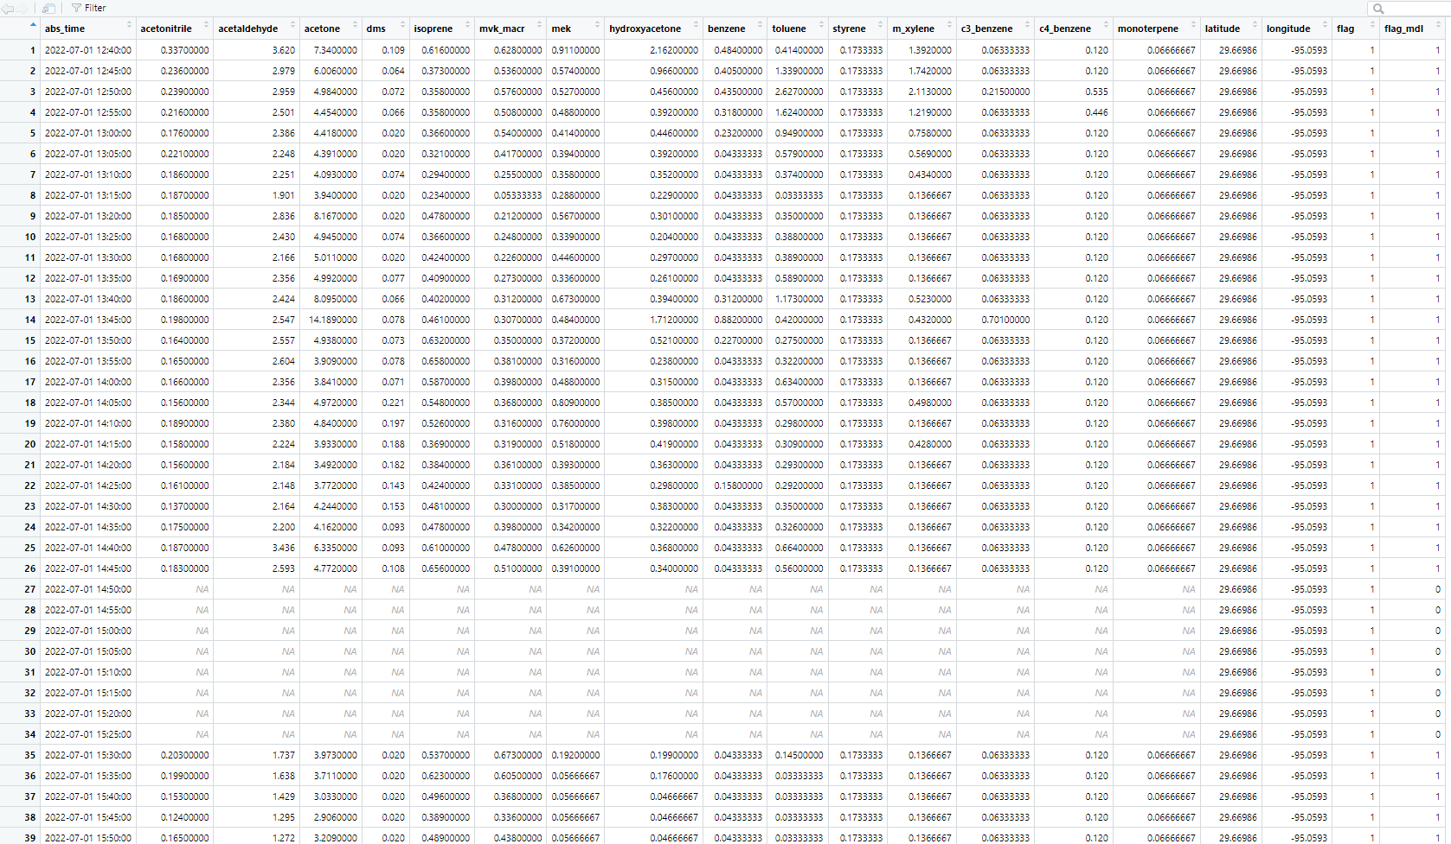
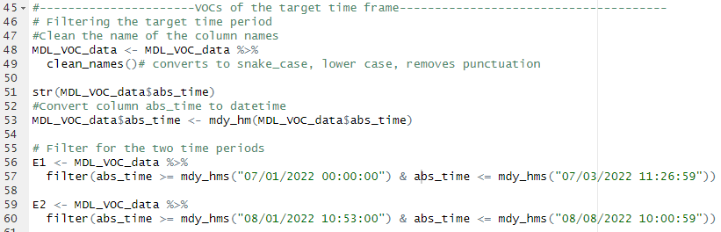
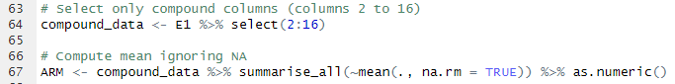
Approach
Clean the new dataset and filtering out the data for a specific time frame
Summarize only the VOCs data

Slide 9
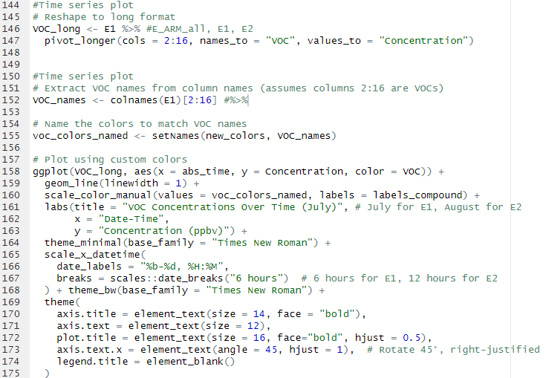
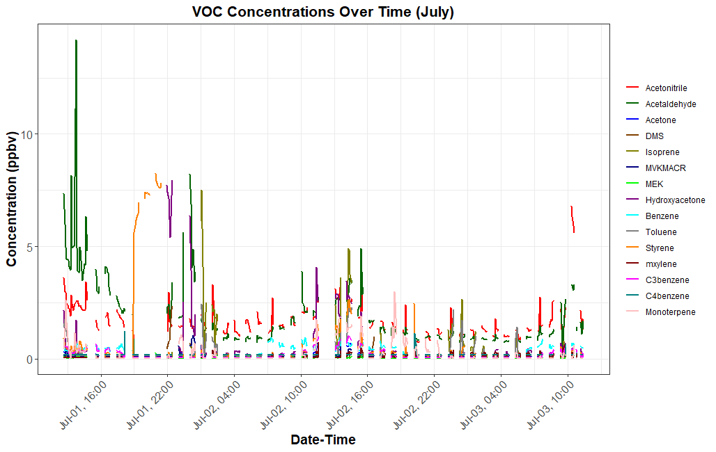
Approach
Visualize VOC trends over time

Slide 10
Approach
# Are there any biomass burning event during this periods?
Event Detection
AAE provides information about the chemical composition of the atmospheric aerosols.
For Black Carbon (BC), AAE ≈ 1
For Brown Carbon (BrC), AAE >> 1, (Schmeisser et al., 2017)
Threshold 1.2
SAE provides information related to aerosol size.
Large particles will have smaller SAE and vice versa.
As dust can also enhance the AAE, an SAE threshold is used to exclude large particle events.
Threshold 1
The combination of AAE and SAE can be used to characterize aerosol type
Enhanced AAE and SAE for at least 4 hours
Notes:
To address the second research question, first biomass burning event was detected based on the AAE and SAE values. For this study, when AAE above 1.2 and SAE above 1, observed for at least 4 hours, then we can identify that time frame as biomass event.

Slide 11
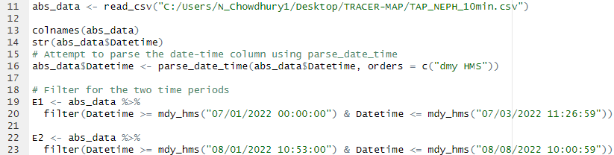
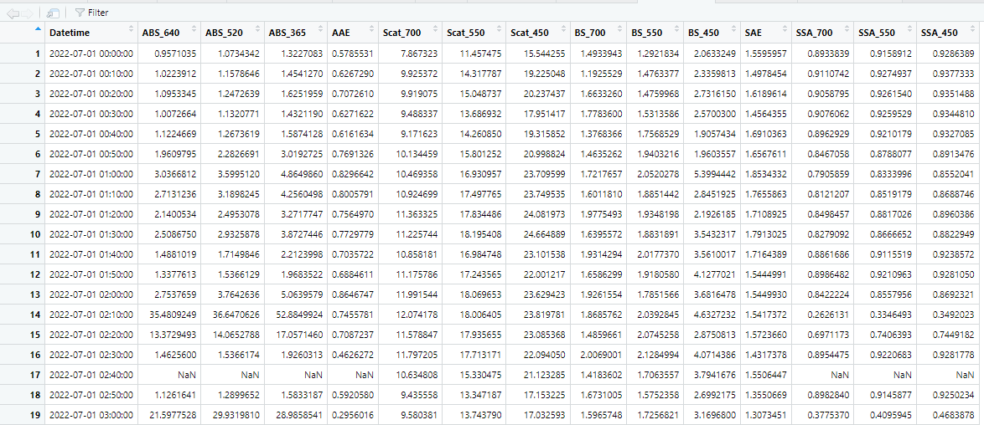
Approach
Filtering AAE and SAE data

Slide 12
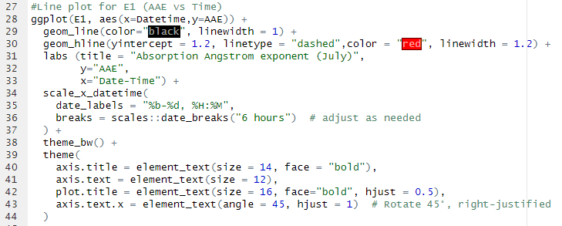
Approach
Time-series plot for AAE

Slide 13
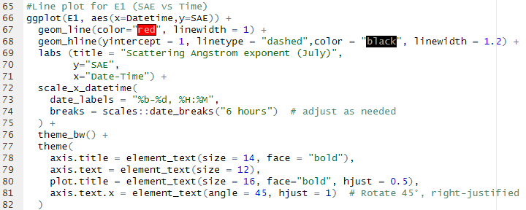
Approach
Time-series plot for SAE

Slide 14
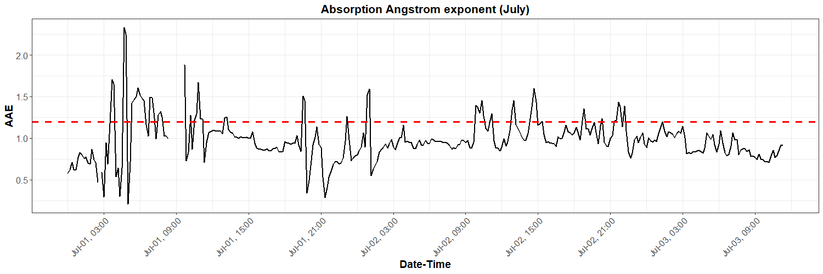
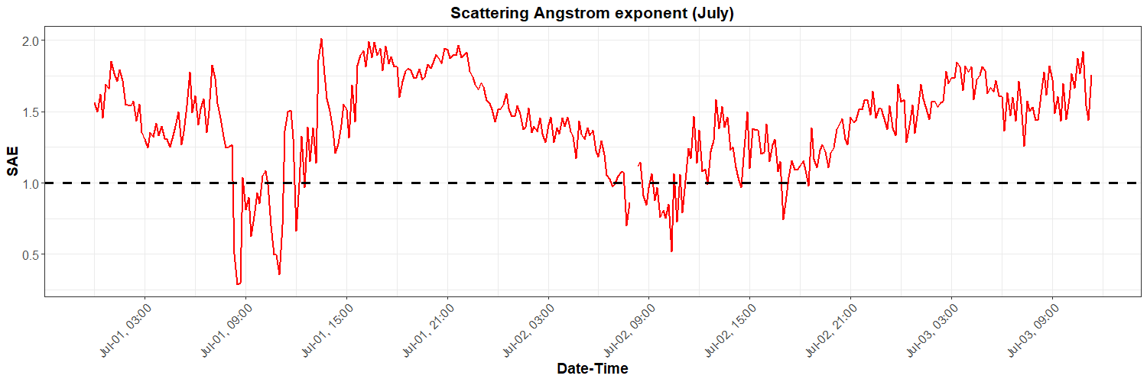
Notes:
This is the time series plot for AAE and SAE for July. You can visualize that no AAE was above 1.2 for at least 4 hours period. The enhanced period of SAE does not comply with the AAE’s.

Slide 15
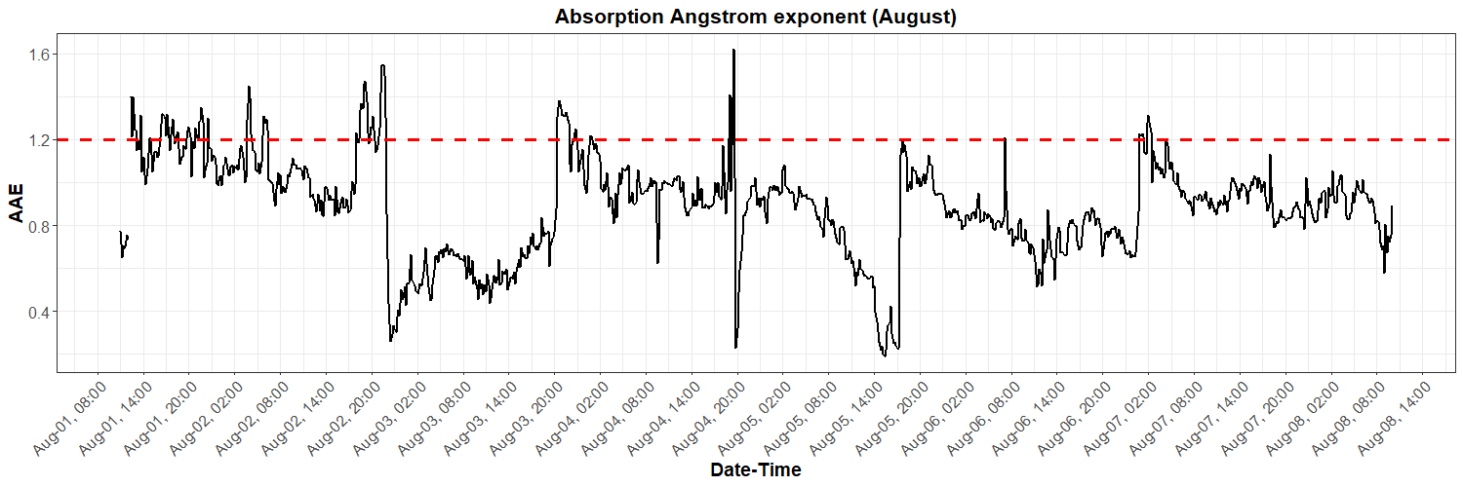
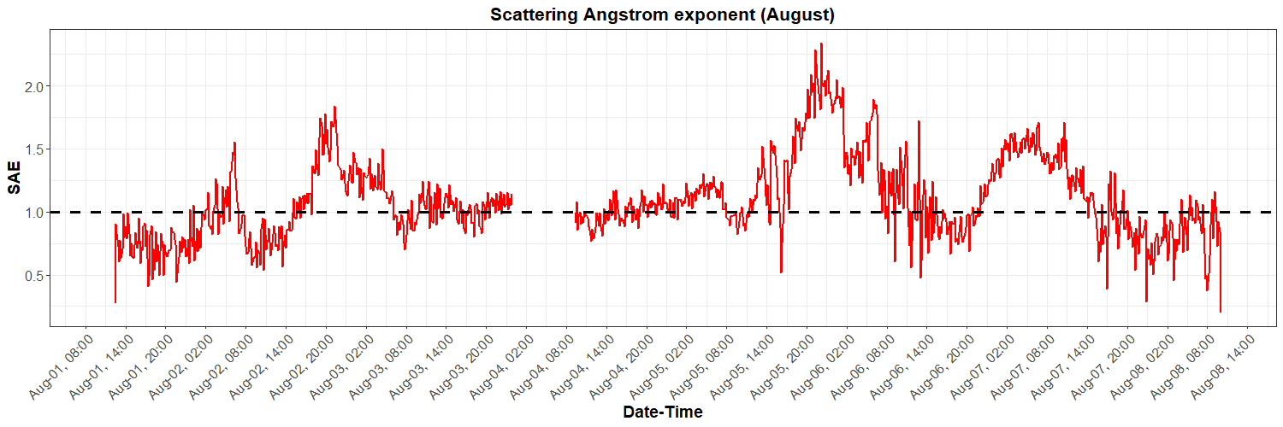
Notes:
. In AAE panel, enhancement is observed from August 2nd 17 o’clock to 23 o’clock or in other words 5 pm to 11 pm, which is 6 hours. So here is out potential biomass burning event. Now let’s look at the SAE to see whether it complies with AAE. And yes, SAE also showed enhancement in same period. From this graph, it can be concluded that the evening air mass of Houston on August 2nd, 2022, was affected by biomass burning event.

Slide 16
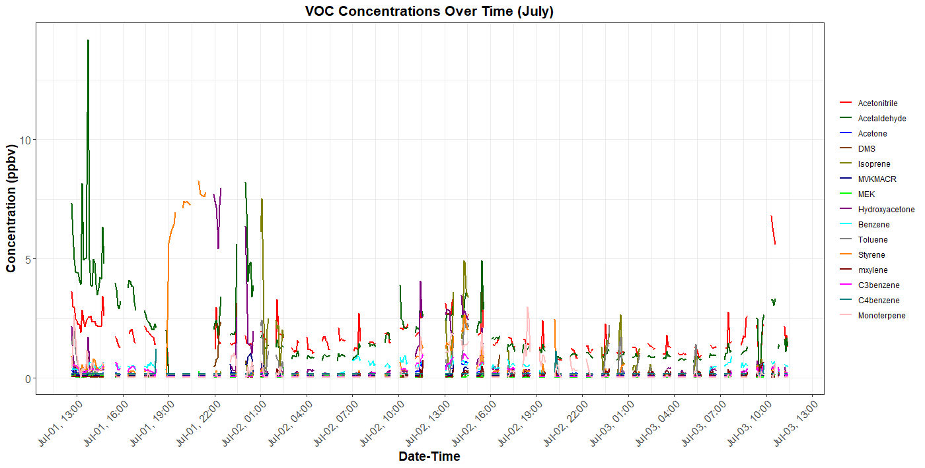
Notes:
Let’s see the result of time series plot for VOCs. Here for July, Acetaldehyde, Acetonitrile, Styrene, and Hydroxyacetone showed some enhancement from mid-day to mid-night of the July 1st. Then, for the rest of the time, you can see a pattern of diurnal variation of the VOC compounds. For example, the vehicular movement increases from the morning to mid-day, you can see that trend of increasing and decreasing

Slide 17
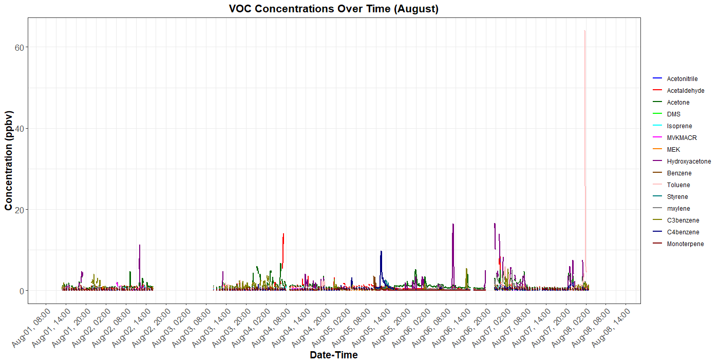
**Outlier

Slide 18
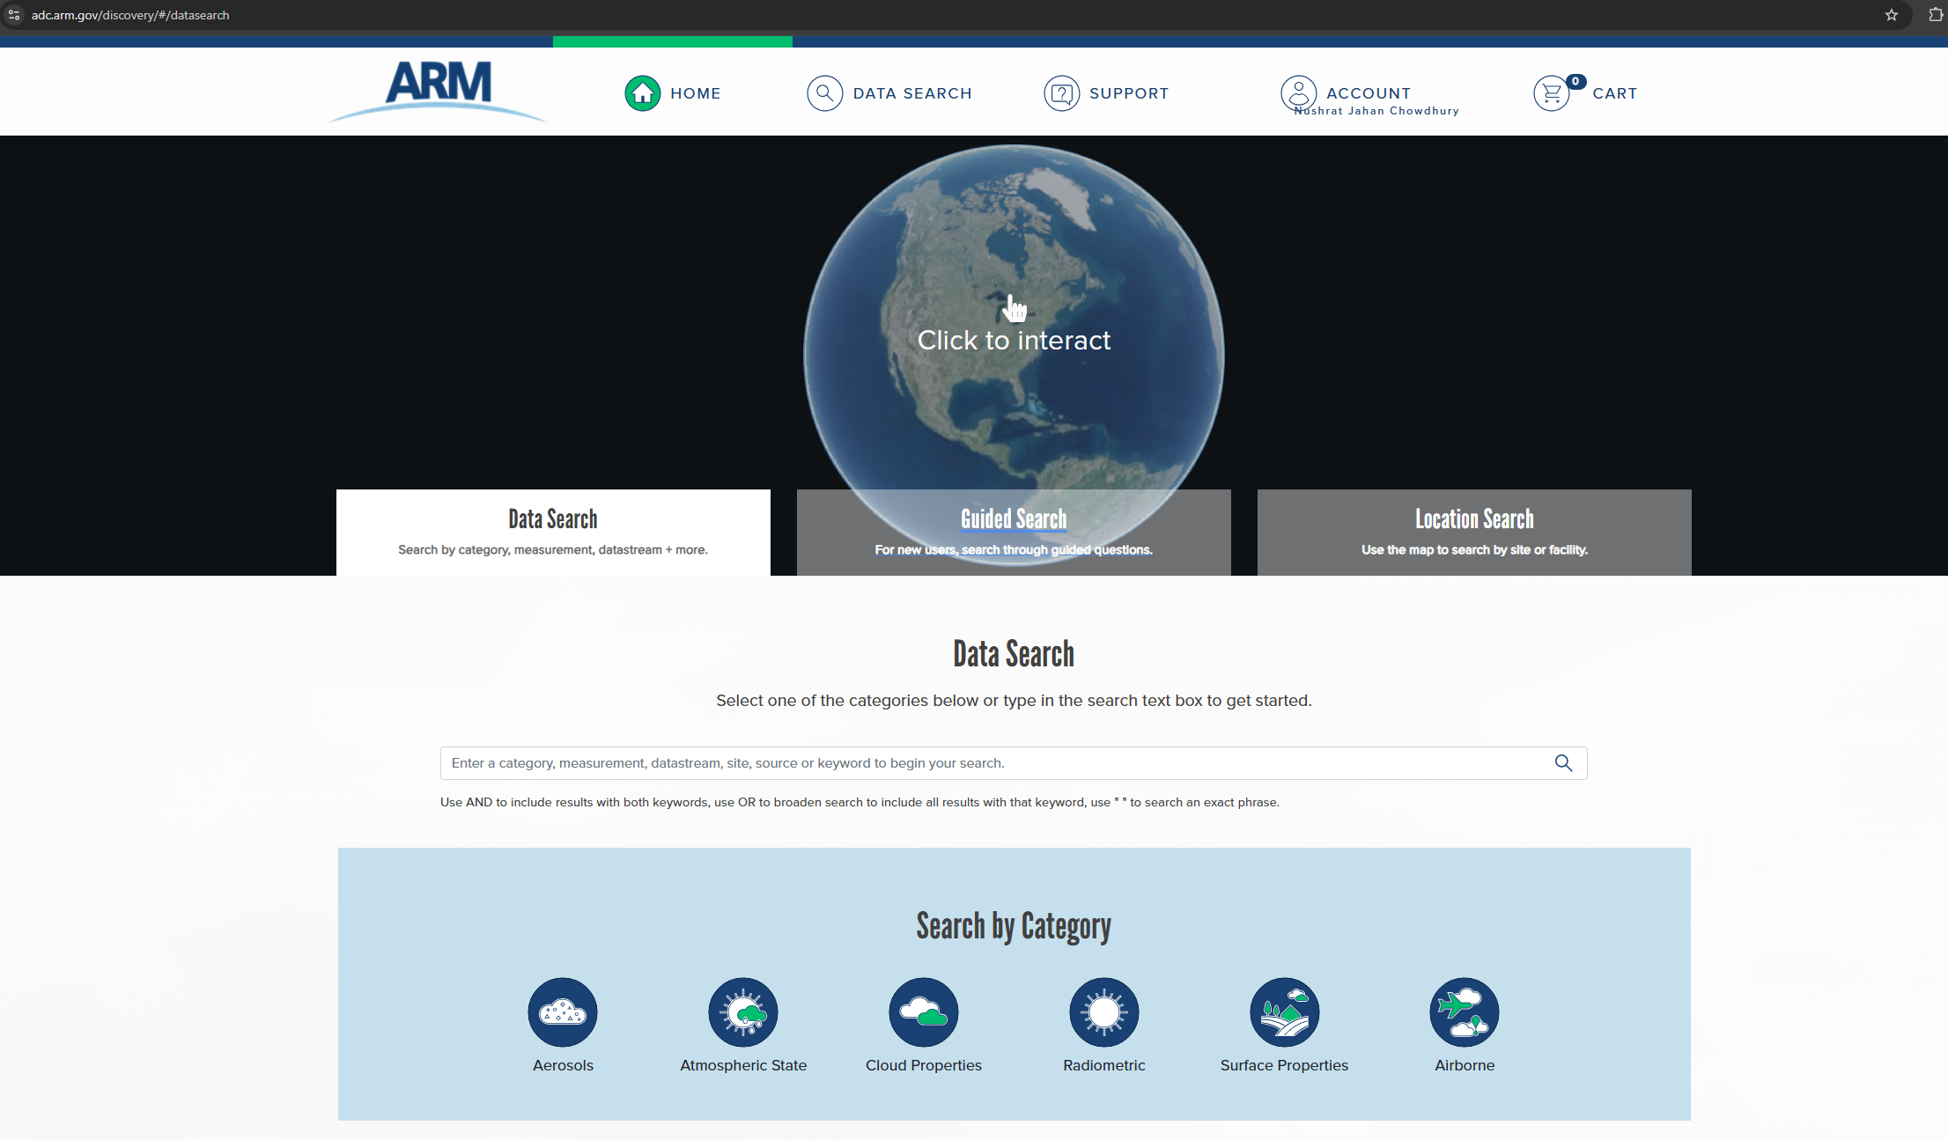
Take Home Message
With similar datasets, one can address these research questions of this tutorial
This R script can generate publishable graphical presentations
Data source: ARM Discovery
https://www.arm.gov/data/

Slide 19
Thank you!!
Presented by
Nushrat Jahan Chowdhury
Bio-5202

Slide 20
References
Shrestha, Sujan, et al. "Evaluation of aerosol-and gas-phase tracers for identification of transported biomass burning emissions in an industrially influenced location in Texas, USA." Atmospheric Chemistry and Physics 23.19 (2023): 10845-10867. (Study on VOCs and formaldehyde in urban air)
Shrestha, Sujan, et al. "Emission Ratios and Diurnal Variability of Volatile Organic Compounds and Influence of Industrial Emissions in Two Texas Cities." Atmosphere 14.6 (2023): 1006.R
Sheesley, Rebecca J., et al. "Downdrafts of Biomass Burning to Houston Enhanced by Local Convective Activity." ACS ES&T Air (2025).
Schmeisser, Lauren, et al. "Classifying aerosol type using in situ surface spectral aerosol optical properties." Atmospheric Chemistry and Physics 17.19 (2017): 12097-12120.
McQueen, Zachary C., et al. "Optical Properties of Biomass Burning Aerosols from Simulated Wildfires and Prescribed Fires with Representative Fuel Beds from the Southeast United States." ACS Es&t Air 1.9 (2024): 1137-1146.
Jin, Yinbao, et al. "Measurement report: Assessing the impacts of emission uncertainty on aerosol optical properties and radiative forcing from biomass burning in peninsular Southeast Asia." Atmospheric Chemistry and Physics 24.1 (2024): 367-395.

